Slide 1

HTML BASIC TAGS
Lecturer :Ms.Lavanya Mohan
Email : lavanya@metaverseage.ae

Slide 2
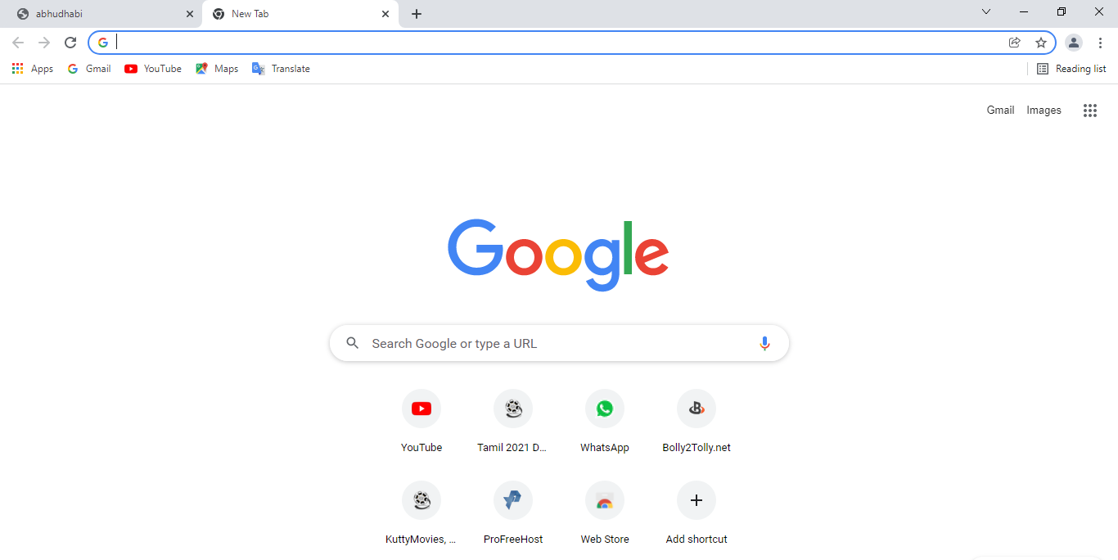
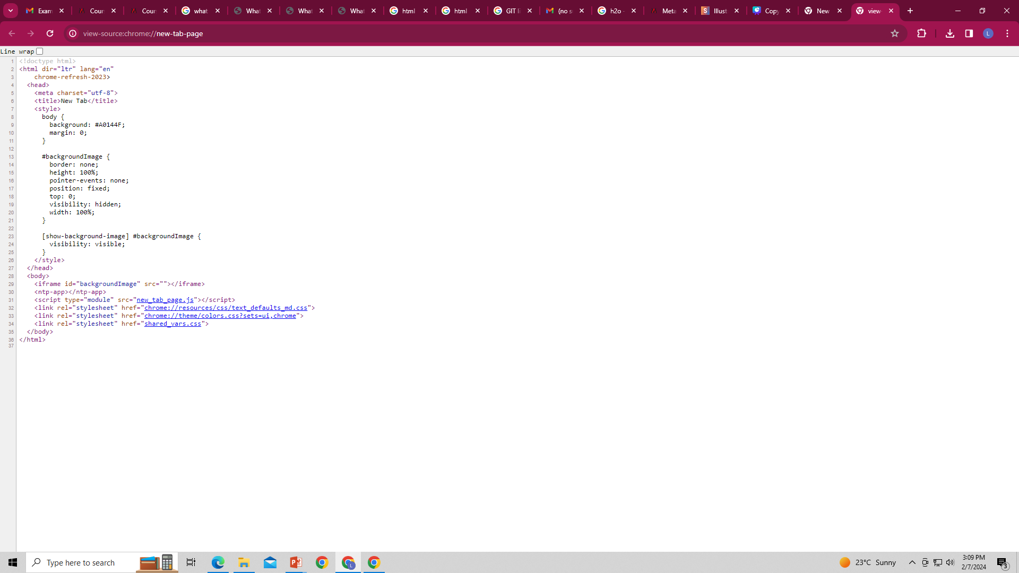
Web page=>
<=Code

Slide 3
Basic Coding
<html>
<title>title Here</title>
<head>Heading Here</head>
<body>
Main page
</body>
</html>

Slide 4
Heading Tag
<h1>hello
<h2>hello
<h3>hello
<h4>hello
<h5>hello

Slide 5
Paragraph Tag
<p>
Keep your face to the sunshine and you cannot see a shadow.” “Once you replace negative thoughts with positive ones, you'll start having positive results.” “Positive thinking will let you do everything better than negative thinking will.”
</p>
Divide Tag
<div>
</div>

Slide 6
Acronym
<acronym title=“Syscoms College”>SC</acronym>
Break
<br>

Slide 7
Center Tag
<center> text/image</center>
Super and Sub
𝑎^2+𝑏^2
a<sup>2</sup>+<b<sup>2</sup>
H2o
H<sub>2</sub>o

Slide 8
Marquee Tool
Description. The HTML <marquee> tag defines a scrolling text area in the HTML document that moves across the page in a horizontal or vertical direction. By default, text found within the <marquee> tag will scroll from right to left.

Slide 9
Marquee Tool
<marquee>hello word </marquee> right to left default
<marquee direction="up">hello welcome to dubai</marquee>
<marquee direction=“down">hello welcome to dubai</marquee>
<marquee direction=“left">hello welcome to dubai</marquee>
Marquee Behavior
<marquee direction="down" width="250" height="200" behavior="alternate" style="border:solid">
<marquee behavior="alternate"> This text will bounce </marquee>

Slide 10
Table
<table border=“1px”>
<tr>
<th> S.N</th>
<th>NAME</th>
<th>AGE</th>
</tr>
<tr>
<td>1</td>
<td>lavan</td>
<td>25</td>
</tr>
<tr>
<td>2</td>
<td>Angelica</td>
</tr>
</table>
S.N | NAME | AGE
1 | lavan | 29

Slide 11
TextBox
username<input type=“text”>
password<input type=“text”>
CheckBox
<input type=“checkbox”>male
<input type=“checkbox”>female

Slide 12
File
<input type=“file”>
Submit Button
<input type=“submit”>
Button
<input type=“button”>
Color
<input type=“color”>

Slide 13
Date
<input type=“date”>
Ratio
<input type=“radio” name=“sys”>male
<input type=“radio” name=“sys”>female
Time
<input type=“time”>

Slide 14
Background color
<Body bgcolor=‘green’>
Image
<img src="C:\Users\Administrator\Desktop\angel\toyy.jpg“>
<img src="C:\Users\Administrator\Desktop\angel\toyy.jpg“ height=“200px” width=“400”

Slide 15
Create Basic registration form by
using html

Slide 16
Thank You

